Slide 1
Oil pipeline accidents
Chethan M(PES2201800331)
Anirudh R(PES2201800068)

Slide 2
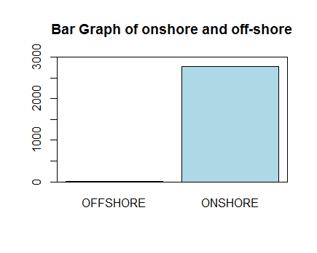
Data visualisation(II)

Slide 3
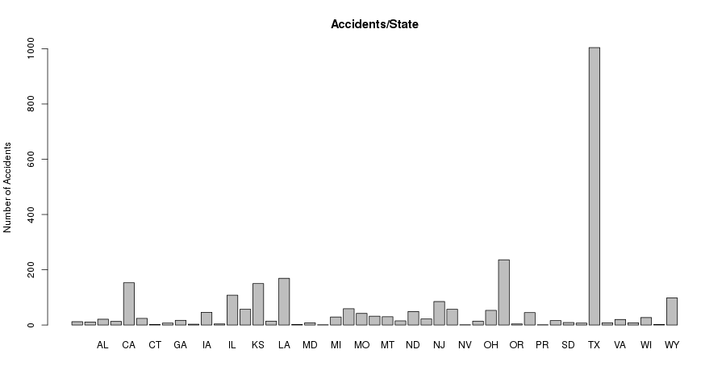

Slide 4
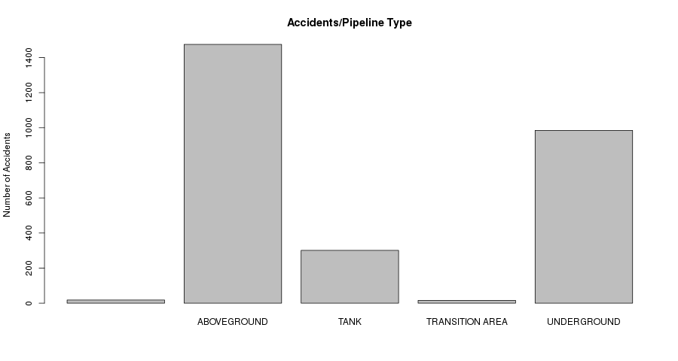

Slide 5
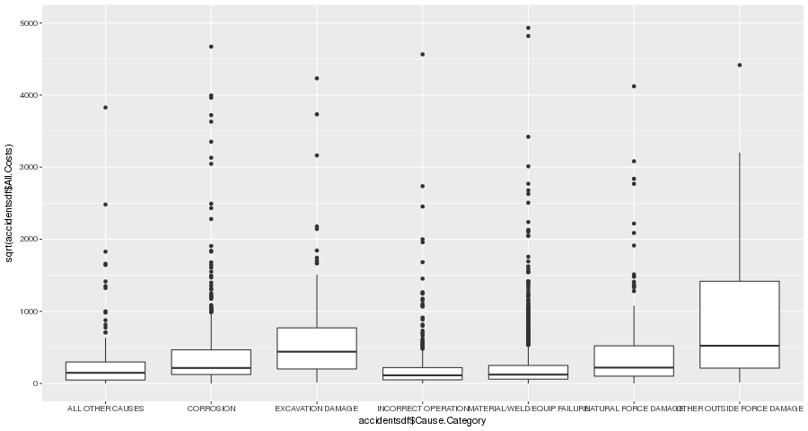

Slide 6
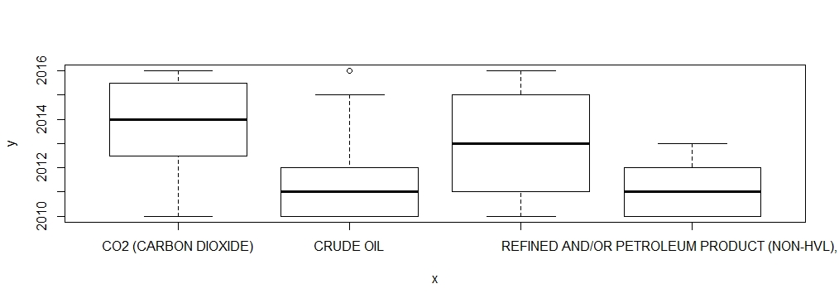

Slide 7
Linear Regression Model
Linear regression is used to predict the value of a continuous variable Y based on one or more input predictor variables X.
The aim of Linear Regression is to find a mathematical equation for a continuous response variable Y as a function of one or more X variable(s).
Y=aX+bY+....+intercept

Slide 8
Modelling
The dataset is split into 2 parts
80% data
20% data
op=read.csv("datasetmain.csv")
library(caTools)
split=sample.split(op,SplitRatio = 0.8)
train=subset(op,split="TRUE")
test=subset(op,split="FALSE")

Slide 9
Modelling-1
Linear Regression will be modelled on the dataset that contains 80% of values (train).
Predictions will be made on the dataset that contains 20% of values (test).
4 variables are used for modelling here :
Intentional oil loss
Unintentional oil loss
Oil recovery
Net loss

Slide 10
corelation
Corelation between allcosts and property damage costs is0.377=37.7% related.
Corelation between allcosts and Lost commodity costs is0.198=19.8% related.
Corelation between allcosts and pubic damge costs is0.712=71.2% related.
Corelation between allcosts and property damage costs is0.377=37.7% related.
Corelation between allcosts and emergency response costs 0.947=94.7%related.
Corelation between allcosts and environment remediation costs 0.420=42%related.
Corelation between allcosts and other costs 0.892=89.2%related.

Slide 11

Creating the Model
net=train$Net.Loss..Barrels.
unint=train$Unintentional.Release..Barrels.
rec=train$Liquid.Recovery..Barrels.
int=train$Intentional.Release..Barrels.
model=lm(net~(unint+int+rec),data=train)
summary(model)

Slide 12

Significance of Model
P-Value =2.2e-16 < 0.05
Standard Error – measures the goodness of fit.
SE= 4.781e-12 (almost 0)
R squared – proportion of variation in dependent variables.
= 1 ( >0.70 )

Slide 13
Correlation
Corelation between unintentional and net loss
is 0.509=50.9% related.
Corelation between intentional and net loss
=0.855=85.5% related.
Corelation between Liquid recovery and net loss
=0.034=3.4% related.

Slide 14
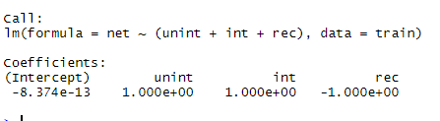
The model
Hence, the model is significant
Net = unint + int - rec – 8.374e-13

Slide 15

Prediction
pred=predict(model,test)
plot(test$Net.Loss..Barrels.,type="l",lty=1.8,col="red")
plot(pred,type="l",lty=1.8,col=“blue")
------------------The data-values are similar--------------------

Slide 16
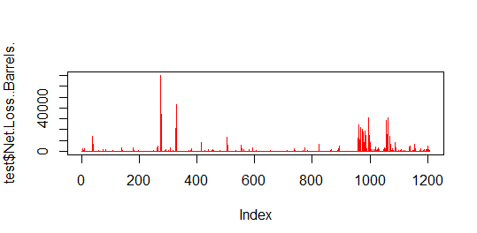
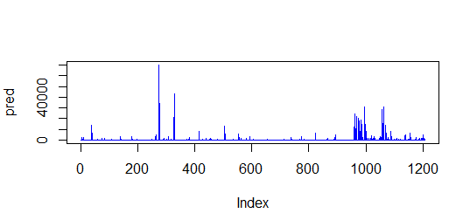
Prediction

Slide 17
Modelling-2
Linear regression will be modelled on the dataset that contains 80% of values.
Predictions will be made on the dataset that contains 20% of values
6 variables are used for modelling
Property damage costs
Lost commodity costs
Public private property costs
Emergency costs
Environment Remediation costs
Other costs

Slide 18
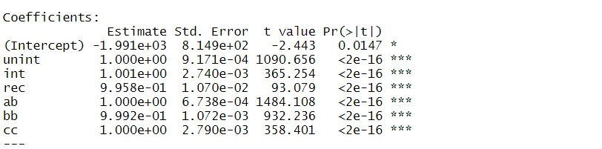
Creating the model
net=train$All.Costs
unint=train$Property.Damage.Costs
rec=train$Lost.Commodity.Costs
int=train$Public.Private.Property.Damage.Costs
ab=train$Emergency.Response.Costs
bb=train$Environmental.Remediation.Costs
cc=train$Other.Costs
model=lm(net~(unint+int+rec+ab+bb+cc),data=train)
Summary(model)

Slide 19


Significance of model
P-value:2.2e-16<0.05
Standard error=measure the goodness of fit.
S.E=9.206e-12(almost 0)
R squared-proportion of variation in dependent variables.=1>(0.70)

Slide 20
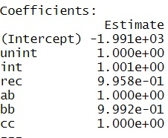
The model
Hence the model is significant
Allcosts=unint+int+rec+ab+bb+cc-1.99e+03

Slide 21

Prediction
pred=predict(model,test)
plot(pred,type="l",lty=1.8,col="red")
lines(pred,type="l",col="blue")
The data values are almost similar

Slide 22
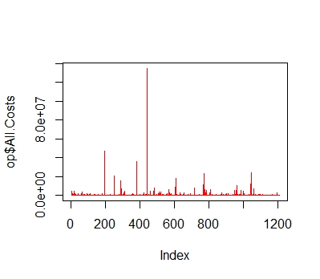
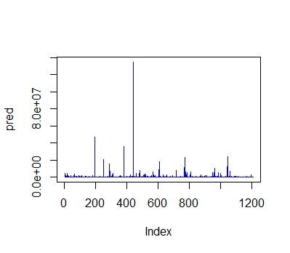
Prediction

Slide 23
Thank you

